Slide 1

UNIT - II
UNIX FILES
By,
Dr. Kuldeep P. Sambrekar

Slide 2
Content
Introduction: File Types,
The UNIX and POSIX File System,
The UNIX and POSIX File Attributes,
Inodes in UNIX System V,
Application Program Interface to Files,
UNIX Kernel Support for Files,
General File APIs,
Directory File APIs ,
Device File APIs,
FIFO File APIs ,
Symbolic Link File APIs,
File and Record Locking.

Slide 3
Files are the building blocks of any OS.
When you execute a command in UNIX, the kernel fetches the executable file from the file system and also any files required for reading and writing.
Files in UNIX and POSIX cover a wide range of file types.
They also provide a common set of interfaces to files.
This chapter covers
  File Types
  File attributes and their uses.
  Kernel and process specific data structures used for file manipulation.

Slide 4
FILE TYPES
Regular file
Directory file
FIFO file
Character device file
Block device file

Slide 5
Regular file
It may be text or binary file
They can be created, browsed and modified by various means such as text editors and compilers.
They can be created with command like vi
To remove regular files use rm command

Slide 6
Directory file
Folder that contains other files and
subdirectories
Provides a means to organize files in
hierarchical structure
To create : mkdir command
To remove : rmdir command
To display : ls command

Slide 7
Block device file :
Physical device which transmits data a
block at a time
EX: hard disk drive, floppy disk drive
Character device file :
Physical device which transmits data
in a character-based manner
EX: line printers, modems, consoles

Slide 8
To create : mknod command
mknod /dev/cdsk c 115 5
/dev/cdsk : name of the device
c -- character device b -- block device
115 — major device number
5 — minor device number
Major device number : an index to the kernel’s
file table that contains address of all device
drivers
Minor device number : indicates the type of
physical file and I/O buffering scheme used
for data transfer

Slide 9
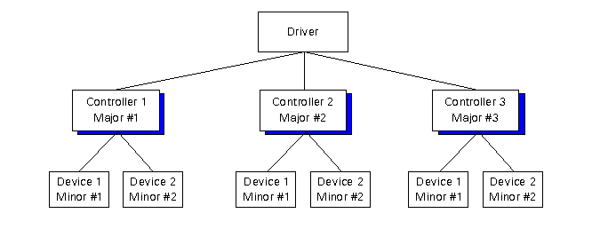
mknod /dev/cdsk c 115 5
115 – major device number: An index to a kernel table that contains the address of device driver functions known to the system.
5 – minor device number: An integer value to be passed as an argument to a device driver function when it is called. It tells which actual device it is talking to.
c – Character device file
b – Block device file

Slide 10
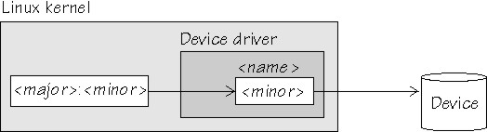
Example

Slide 11
FIFO file
Special pipe device file which provides a
temporary buffer for two or more processes to communicate by writing data to and reading data from the buffer
Max size of buffer – PIPE_BUF
The storage is temporary
The file exists as long as there is one process in direct connection to the fifo for data access

Slide 12
Example
Caller 1
Line - 1
Receiver 1
Telephone exchange office
Caller 2
Receiver 2
Line - 2

Slide 13
Technical example
SYSTEM – 1
PRINTER
SYSTEM – 2
BUFFER
SYSTEM – 3

Slide 14
To create : mkfifo OR mkfifo
mkfifo /usr/prog/fifo_pipe
mknod /usr/prog/fifo_pipe p
A fifo file can be removed like any other
regular file

Slide 15
Symbolic link file
A symbolic link file contains a pathname
which references another file in either the
local or a remote file system
To create : ln command with –s option
ln –s /usr/abc/original /usr/xyz/slink
cat /usr/xyz/slink
/*will print contents of /usr/abc/original file*/

Slide 16
UNIX and POSIX file systems
They have a tree-like hierarchical
file system
“/” – denotes the root
“.” – current directory
“..” – parent directory
NAME_MAX – max number of characters
in a file name
PATH_MAX -- max number of characters
in a path name

Slide 17
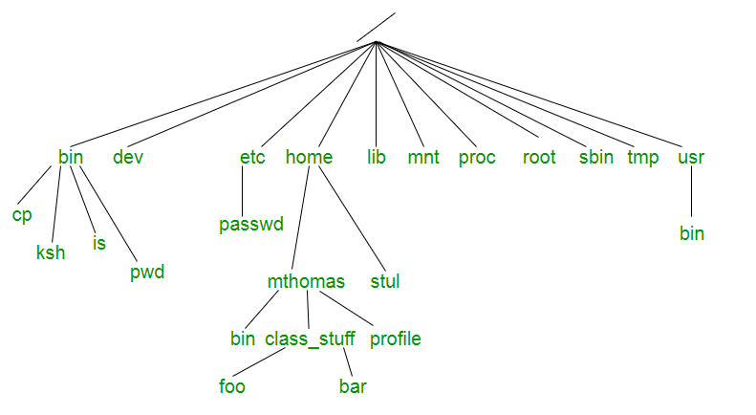
FILE SYSTEM

Slide 18
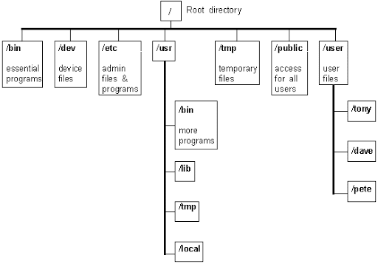
Example

Slide 19
Common UNIX files
/etc : Stores system
administrative files &
programs
/etc/passwd : Stores all user information
/etc/shadow : Stores user passwords
/etc/group : Stores all group
information

Slide 20
/bin : Stores all system programs
/dev : Stores all character and
block device files
/usr/include : Stores standard
header files
/usr/lib : Stores standard libraries
tmp : Stores all temporary files
created by programs

Slide 21
UNIX and POSIX file attributes
All the attributes of a file can be displayed by the command ls –l(long listing of files)
File type : type of file
Access permission : the file access
permission for
owner group and
others
Hard link count : number of hard
links of a file

Slide 22
UID : the file owner user
ID
GID : the file group ID
File size : the file size in
bytes
Last access time : the time the file
was last accessed
Last modify time : the time the file was
last modified

Slide 23
Last change time : the time the file
access permission
UID ,GID
or hard link count
was last changed

Slide 24
Inode number : the system inode
number of the file
File system ID : the file system ID
where the file is
stored

Slide 25
Attributes of a file that remain unchanged
File type
File inode number
File system ID
Major and minor device number
Other attributes are changed using UNIX
commands or system calls

Slide 26
Inodes in UNIX
In UNIX System V, a file system has an inode table which keeps track of all files.
Each inode table is an inode record contains all attributes of a file including inode no and physical disk address.
Each inode no is unique to a file system only.
An OS does not keep the name of a file in its inode record. The mapping from file names to inode nos is done through directory files.

Slide 27
Inodes in UNIX
To access a file, for example /usr/joe
  The UNIX kernel knows the /directory inode no – it is kept in process-U area.
  It will scan the “/” directory file to find the inode no of usr file.
  Once it gets the inode no, it checks if the calling process has permission to search usr directory.
  It then looks for the joe file.
Whenever a new file is created in directory, entry is made in inode table and directory file.
Inode tables are kept in their file systems on disk, but the UNIX kernel maintains an in-memory inode table to contain a copy of the recently accessed inode records.

Slide 28
APPLICATION PROGRAM INTERFACE TO FILES
Files are identified by path names
Files must be created before they can be used.
Files must be opened before they can be accessed by application programs. open system call is for this purpose, which returns a file descriptor, which is a file handle used in other system calls to manipulate the open file

Slide 29
Application Program Interface to Files
Files are identified by path names
Files must be created before they can be used.
File type | UNIX Command | UNIX and POSIX.1 System call
Regular Files | Vi, emacs..etc | Open, creat
Directory Files | mkdir | mkdir, mknod
FIFO Files | mkfifo | mkfifo, mknod
Device Files | mknod | Mknod
Symbolic Files | ln –s | Symlink

Slide 30
UNIX KERNEL SUPPORT FOR FILES
Example:
Consider:
1. If you want to open a file.
What will you do?
Just double click on the file and the file gets opened…..
But have you ever thought how this process works in the background????

Slide 31
UNIX KERNEL SUPPORT FOR FILES
Whenever the process calls the open function to open a file to read or write, the kernel will resolve the pathname to the file inode number.
File table – All open files
Inode Table – copy of file inodes most recently accessed
File descriptor Table – All files opened by the Process, OPEN_MAX

Slide 32
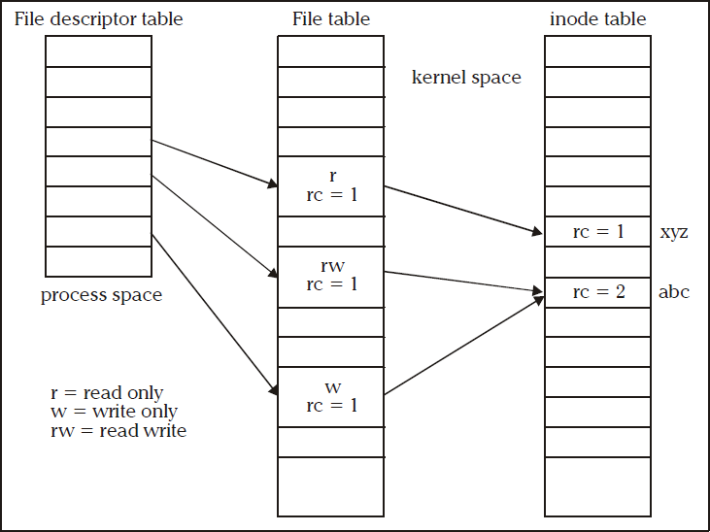
UNIX Kernel Support for Files
Data Structure fPRoOFr. SYFEDiMlUeSTAMFA, HKaBKnCEipulation
36

Slide 33
The steps involved are :
UNIX Kernel Support for Files
The kernel will search the process file descriptor table and look for the first unused entry.
If an entry is found, that entry will be designated to reference the file .The index of the entry will be returned to the process as the file descriptor of the opened file.
The kernel will scan the file table in its kernel space to find an unused entry that can be assigned to reference the file.

Slide 34
UNIX Kernel Support for Files
If an unused entry is found the following events will occur:
The process file descriptor table entry will be set to point to this file table entry.
The file table entry will be set to point to the inode table entry, where the inode record of the file is stored.
The file table entry will contain the current file pointer of the open file. This is an offset from the beginning of the file where the next read or write will occur.
The file table entry will contain an open mode that specifies that the file opened is for read only, write only or read and write etc. This should be specified in open function call.

Slide 35
UNIX Kernel Support for Files
If an unused entry is found the following events will occur:
The reference count (rc) in the file table entry is set to 1. Reference count is used to keep track of how many file descriptors from any process are referring the entry.
The reference count of the in-memory inode of the file is increased by 1. This count specifies how many file table entries are pointing to that inode.
If either (1) or (2) fails, the open system call returns -1 (failure/error)

Slide 36
Close function
The kernel sets the FD entry to be unused
Decrement the reference count in file table by 1. If still non-zero, go to 6.
The file table entry is marked as unused.
Decrement the reference count in file inode table by 1, if still non-zero, go to 6.
If hard-link count of inode is non zero, return to caller. Otherwise it marks the inode table entry as unused and deallocates all the physical disk storage of the file, as all the file path names have been removed by some process.
It returns to the process with a 0 (success) status.

Slide 37
Directory files
Directory is a record oriented file.
Record data type is struct dirent in UNIX V and POSIX.1, and struct direct in BSD UNIX
Unix system also provides telldir and seekdir function
Directoryfunction opendir readdir closedir rewinddir | Purpose Opens a directory file Reads next record from file closes a directory file Sets file pointer to beginning of file

Slide 38
Directory File APIs
Why do we need directory files?
To aid users in organizing their files into some structure based on the specific use of files
They are also used by the operating system to convert file path names to their inode numbers

Slide 39
To create
int mkdir (const char* path_name , mode_t
mode);
The mode argument specifies the access permission for the owner, group, and others to be assigned to the file.

Slide 40
Difference between mkdir and mknod
Directory created by mknod API does not contain the “.” and “..” links. These links are accessible only after the user explicitly creates them.
Directory created by mkdir has the “.” and “..” links created in one atomic operation, and it is ready to be used.
One can create directories via system API’s as well.

Slide 41
A newly created directory has its user ID set to the effective user ID of the process that creates it.
Directory group ID will be set to either the effective group ID of the calling process or the group ID of the parent directory that hosts the new directory.

Slide 42
FUNCTIONS
Opendir:
DIR* opendir (const char* path_name);
This opens the file for read-only
Readdir:
Dirent* readdir(DIR* dir_fdesc);
The dir_fdesc value is the DIR* return
value from an opendir call.

Slide 43
Closedir :
int closedir (DIR* dir_fdesc);
It terminates the connection between the
dir_fdesc handler and a directory file.
Rewinddir :
void rewinddir (DIR* dir_fdesc);
Used to reset the file pointer associated
with a dir_fdesc.

Slide 44
Rmdir API:
int rmdir (const char* path_name);
Used to remove the directory files. Users
may also use the unlink API to remove
directories provided they have super user
privileges.
These API’s require that the directories to
be removed must be empty, in that they contain no files other than “.” and “..” links.

Slide 45
Device file APIs
Device files are used to interface physical devices (ex: console, modem) with application programs.
Device files may be character-based or block-based
The only differences between device files and regular files are the ways in which device files are created and the fact that lseek is not applicable for character device files.

Slide 46
To create:
int mknod(const char* path_name, mode_t
mode,int device_id);
The mode argument specifies the access permission of the file
The device_id contains the major and minor device numbers. The lowest byte of a device_id is set to minor device number and the next byte is set to the major device number.

Slide 47
MAJOR AND MINOR NUMBERS
When a process reads from or writes to a device file, the file’s major device number is used to locate and invoke a device driver function that does the actual data transmission.
The minor device number is an argument being passed to a device driver function when it is invoked. The minor device number specifies the parameters to be used for a particular device type.

Slide 48
A device file may be removed via the unlink API.
If O_NOCTTY flag is set in the open call, the kernel will not set the character device file opened as the controlling terminal in the absence of one.
The O_NONBLOCK flag specifies that the open call and any subsequent read or write calls to a device file should be non blocking to the process.

Slide 49
FIFO File APIs
These are special device files used for inter process communication.
These are also known as named pipes.
Data written to a FIFO file are stored in a fixed-size buffer and retrieved in a
first-in-first-out order.
To create:
int mkfifo( const char* path_name, mode_t
mode);

Slide 50
How is synchronization provided?
When a process opens a FIFO file for read-only, the kernel will block the process until there is another process that opens the same file for write.
If a process opens a FIFO for write, it will be blocked until another process opens the FIFO for read.
This provides a method for process
synchronization

Slide 51
If a process writes to a FIFO that is full, the process will be blocked until another process has read data from the FIFO to make room for new data in the FIFO.
If a process attempts to read data from a FIFO that is empty, the process will be blocked until another process writes data to the FIFO.
If a process does not desire to be blocked by a FIFO file, it can specify the O_NONBLOCK flag in the open call to the FIFO file.

Slide 52
UNIX System V defines the O_NDELAY flag which is similar to the O_NONBLOCK flag. In case of O_NDELAY flag the read and write functions will return a zero value when they are supposed to block a process.
If a process writes to a FIFO file that has no other process attached to it for read, the kernel will send a SIGPIPE signal to the process to notify it of the illegal operation.

Slide 53
If Two processes are to communicate via a FIFO file, it is important that the writer process closes its file descriptor when it is done, so that the reader process can see the end-of-file condition.
Pipe API
Another method to create FIFO files for
inter process communications
int pipe (int fds[2]);

Slide 54
Uses of the fds argument are:
fds[0] is a file descriptor to read
data from the FIFO file.
fds[1] is a file descriptor to write
data to a FIFO file.
The child processes inherit the FIFO file descriptors from the parent, and they can communicate among themselves and the parent via the FIFO file.

Slide 55
Symbolic Link File APIs
These were developed to overcome several shortcomings of hard links:
Symbolic links can link from across file systems
Symbolic links can link directory files
Symbolic links always reference the latest version of the file to which they link
Hard links can be broken by removal of one or more links. But symbolic link will not be broken.

Slide 56
To create :
int symlink (const char* org_link, const
char* sym_link);
int readlink (const char* sym_link, char* buf,
int size);
int lstat (const char* sym_link, struct stat*
statv);

Slide 57
FILE AND RECORD LOCKING
UNIX systems allow multiple processes to read and write the same file concurrently.
It is a means of data sharing among processes.
Why we need to lock files? It is needed in some applications like database access where no other process can write or read a file while a process is accessing a data base.
Unix and POSIX systems support a file-locking mechanism.
File locking is applicable only to regular files.

Slide 58
Shared and exclusive locks
A read lock is also called a shared lock and a write lock is called an exclusive lock.
These locks can be imposed on the whole file or a portion of it.
A write lock prevents other processes from setting any overlapping read or write locks on the locked regions of a file.
The intention is to prevent other processes from both reading and writing the locked region while a process is modifying the region.

Slide 59
A read lock allows processes to set overlapping read locks but not write locks. Other processes are allowed to lock and read data from the locked regions.
A mandatory locks can cause problems: If a runaway process sets a mandatory exclusive lock on a file and never unlocks it, no other processes can access the locked region of the file until either a runaway process is killed or the system is rebooted.

Slide 60
If a file lock is not mandatory, it is an advisory. An advisory lock is not enforced by a kernel at the system call level
The following procedure is to be followed
Try to set a lock at the region to be accessed. if this fails, a process can either wait for the lock request to become successful or go do something else and try to lock the file again.
After a lock is acquired successfully, read or write the locked region.
Release the lock after read or write operation to the file.

Slide 61
Advisory locks
A process should always release any lock that it imposes on a file as soon as it is done.
An advisory lock is considered safe, as no runaway processes can lock up any file forcefully. It can read or write after a fixed number of failed attempts to lock the file
Drawback: the programs which create processes to share files must follow the above locking procedure to be cooperative.

Slide 62
FCNTL file locking
int fcntl (int fdesc, int cmd_flag, …);
Cmd_flag
F_SETLK
F_SETLKW
F_GETLK
Use
Sets a file lock. Do not block if this
cannot succeed immediately.
Sets a file lock and blocks the
calling process until the lock is
acquired.
Queries as to which process locked
a specified region of a file.

Slide 63
For file locking, the third argument is an address of a struct flock-typed variable.
This lock specifies a region of a file where the lock is to be set, unset or queried.
struct flock
{
short l_type;
short l_whence;
off_t l_start;
off_t l_len;
pid_t l_pid;
};

Slide 64
l_type and l_whence fields of flock
l_type value Use
F_RDLCK Sets as a read (shared) lock
on a specified region
F_WRLCK Sets a write (exclusive) lock
on a specified region
F_UNLCK Unlocks a specified region

Slide 65
l_whence value Use
SEEK_CUR The l_start value is
added to the current file
pointer address
SEEK_SET The l_start value is
added to byte 0 of file
SEEK_END The l_start value is
added to the end
(current size) of the file

Slide 66
The l_len specifies the size of a locked region beginning from the start address defined by l_whence and l_start. If l_len is 0 then the length of the lock is imposed on the maximum size and also as it extends. It cannot have a –ve value.
When fcntl is called, the variable contains the region of the file locked and the ID of the process that owns the locked region. This is returned via the l_pid field of the variable.

Slide 67
LOCK PROMOTION AND SPLITTING
If a process sets a read lock and then sets a write lock on the file, the
process will own only the write lock. This process is called lock promotion.
If a process unlocks any region in between the region where the lock existed then that lock is split into two locks over the two remaining regions.

Slide 68
Mandatory locks can be achieved by setting the following attributes of a file.
Turn on the set-GID flag of the file.
Turn off the group execute right of the file.
All file locks set by a process will be
unlocked when process terminates.
If a process locks a file and then creates a
child process via fork, the child process
will not inherit the lock.
The return value of fcntl is 0 if it succeeds
or -1 if it fails.

Slide 69
#include <iostream.h>
#include <stdio.h>
#include <sys/types.h>
#include <fcntl.h>
#include <unistd.h>
int main (int argc, char* argv[])
{
struct flock fvar;
int fdesc;

Slide 70
while (--argc > 0) { /* do the following for each file */
if ((fdesc=open(*++argv,O_RDWR))==-1)
{
perror("open"); continue;
}
fvar.l_type = F_WRLCK;
fvar.l_whence = SEEK_SET;
fvar.l_start = 0;
fvar.l_len = 0;

Slide 71
/* Attempt to set an exclusive (write) lock on the entire file */
while (fcntl(fdesc, F_SETLK,&fvar)==-1)
{
/* Set lock fails, find out who has locked the file */
while (fcntl(fdesc,F_GETLK,&fvar)!=-1 &&
fvar.l_type!=F_UNLCK)
{
cout << *argv << " locked by " << fvar.l_pid<< " from " << fvar.l_start << " for "<< fvar.l_len << " byte for " <<

Slide 72
(fvar.l_type==F_WRLCK ? 'w' : 'r') << endl;
if (!fvar.l_len) break;
fvar.l_start += fvar.l_len;
fvar.l_len = 0;
} /* while there are locks set by other processes */
} /* while set lock un-successful */

Slide 73
// Lock the file OK. Now process data in the file
/* Now unlock the entire file */
fvar.l_type = F_UNLCK;
fvar.l_whence = SEEK_SET;
fvar.l_start = 0;
fvar.l_len = 0;
if (fcntl(fdesc, F_SETLKW,&fvar)==-1)
perror("fcntl");
}
return 0;
} /* main */

Slide 74
QUESTIONS
Explain the access mode flags and access modifier flags. Also explain how the permission value specified in an ‘Open’ call is modified by its calling process ‘unmask, value. Illustrate with an example (10)
Explain the use of following APIs (10)
i) fcntl ii) lseek iii) write iv) close

Slide 75
With suitable examples explain various directory file APIs (10)
Write a C program to illustrate the use of mkfifo ,open ,read & close APIs for a FIFO file (10)
Differentiate between hard link and symbolic link files with an example (5)
Describe FIFO and device file classes (5)
Explain process of changing user and group ID of files (5)

Slide 76
What are named pipes? Explain with an example the use of lseek, link, access with their prototypes and argument values (12)
Explain how fcntl API can be used for file record locking (8)
Describe the UNIX kernel support for a process . Show the related data
structures (10)

Slide 77
Give and explain the APIs used for the following (10)
To create a block device file called SCS15 with major and minor device number 15 and 3 respectively and access rights read-write-execute for everyone
To create FIFO file called FIF05 with access permission of read-write-execute for everyone

